Slide 1
Infix and postfix Expression conversions
By - G Daniel Vineel

Slide 2
what IS Infix Expression
If the expression contains operator in between of two operands then it is known as infix expression
Ex:
A+B
10-43
WHAT IS POSTFIX EXPRESSION
If the expression contains the operator at the end of their operands then it is known as postfix expression
Ex:
A B +
10 43 -

Slide 3
Common Validation Rules for Both infix and postfix Expressions
The Expression should not contain any special symbols
We need to check whether all the parenthesis are closing and matching properly
Before Converting we need to make sure that the expression following their individual validation rules

Slide 4
Validation Rules for Infix Expression
We need to check no 2 or more consecutive operators are present
Expressions should neither Start nor End with Operators
It should not contain empty braces
The count of braces should be matched
At least one operand should be present

Slide 5
Validation Rules for Postfix Expression
It should not start with operators
We need to consider space so that we can distinguish between operands and their length
More Operators should not be present

Slide 6
What is the unique in this compared to online platforms
In most of the online platforms they are not considering more length operands like
abc + gtg, 109-98.
Even though they are many online platforms are present many are forgot the check double or more consecutive operators in infix expression
The most and main important thing Almost no one thinks about unary minus values like
-19+1,-gn+sd*(-tc)

Slide 7
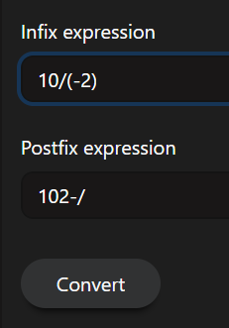
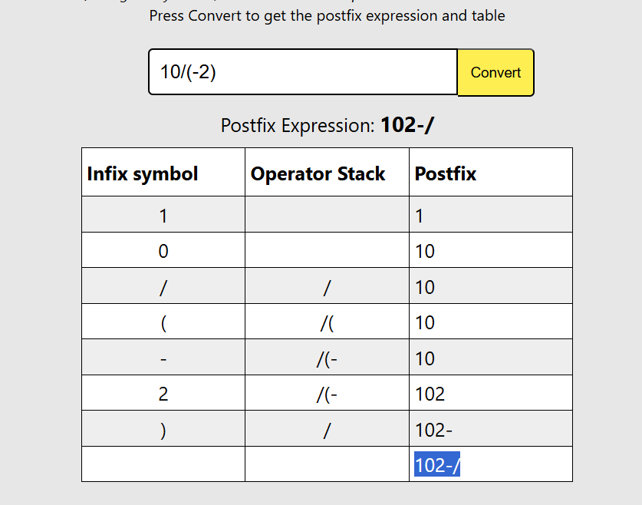
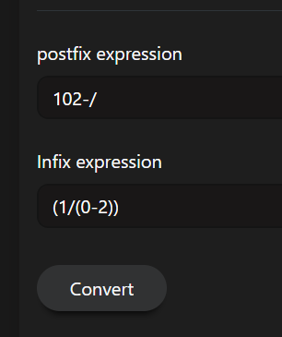
Examples

Slide 8
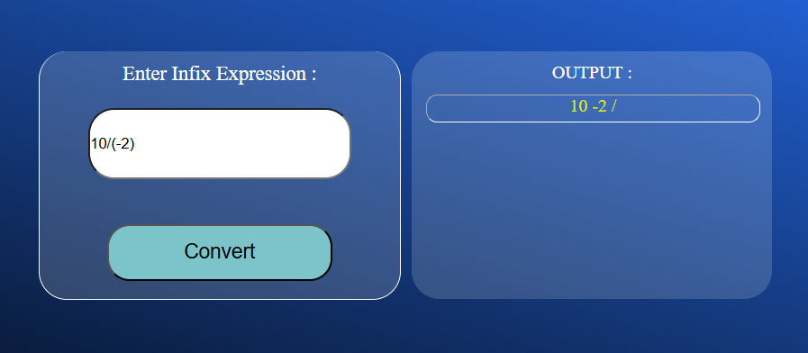
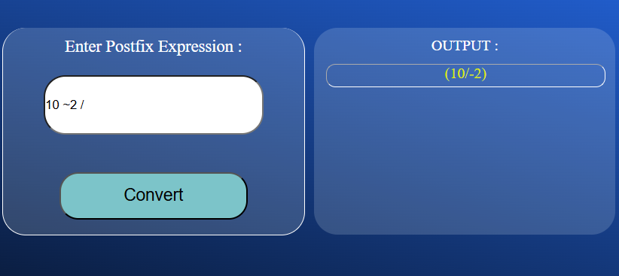
MY Solutions

Slide 9
Technologies Used
python
HTML
CSS
JAVASCRIPT
Flask Library

Slide 10
Thankyou
Any questions or doubts..?

